Slide 1
Creating Linux & windows instances
→by team aws era

Slide 2
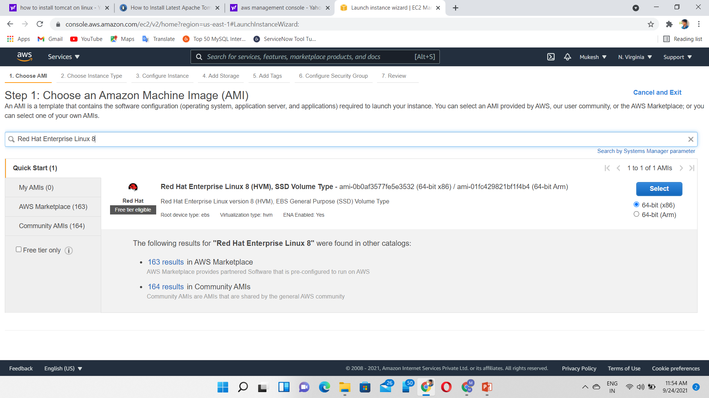
Step 1-How to choose linux image (os)

Slide 3
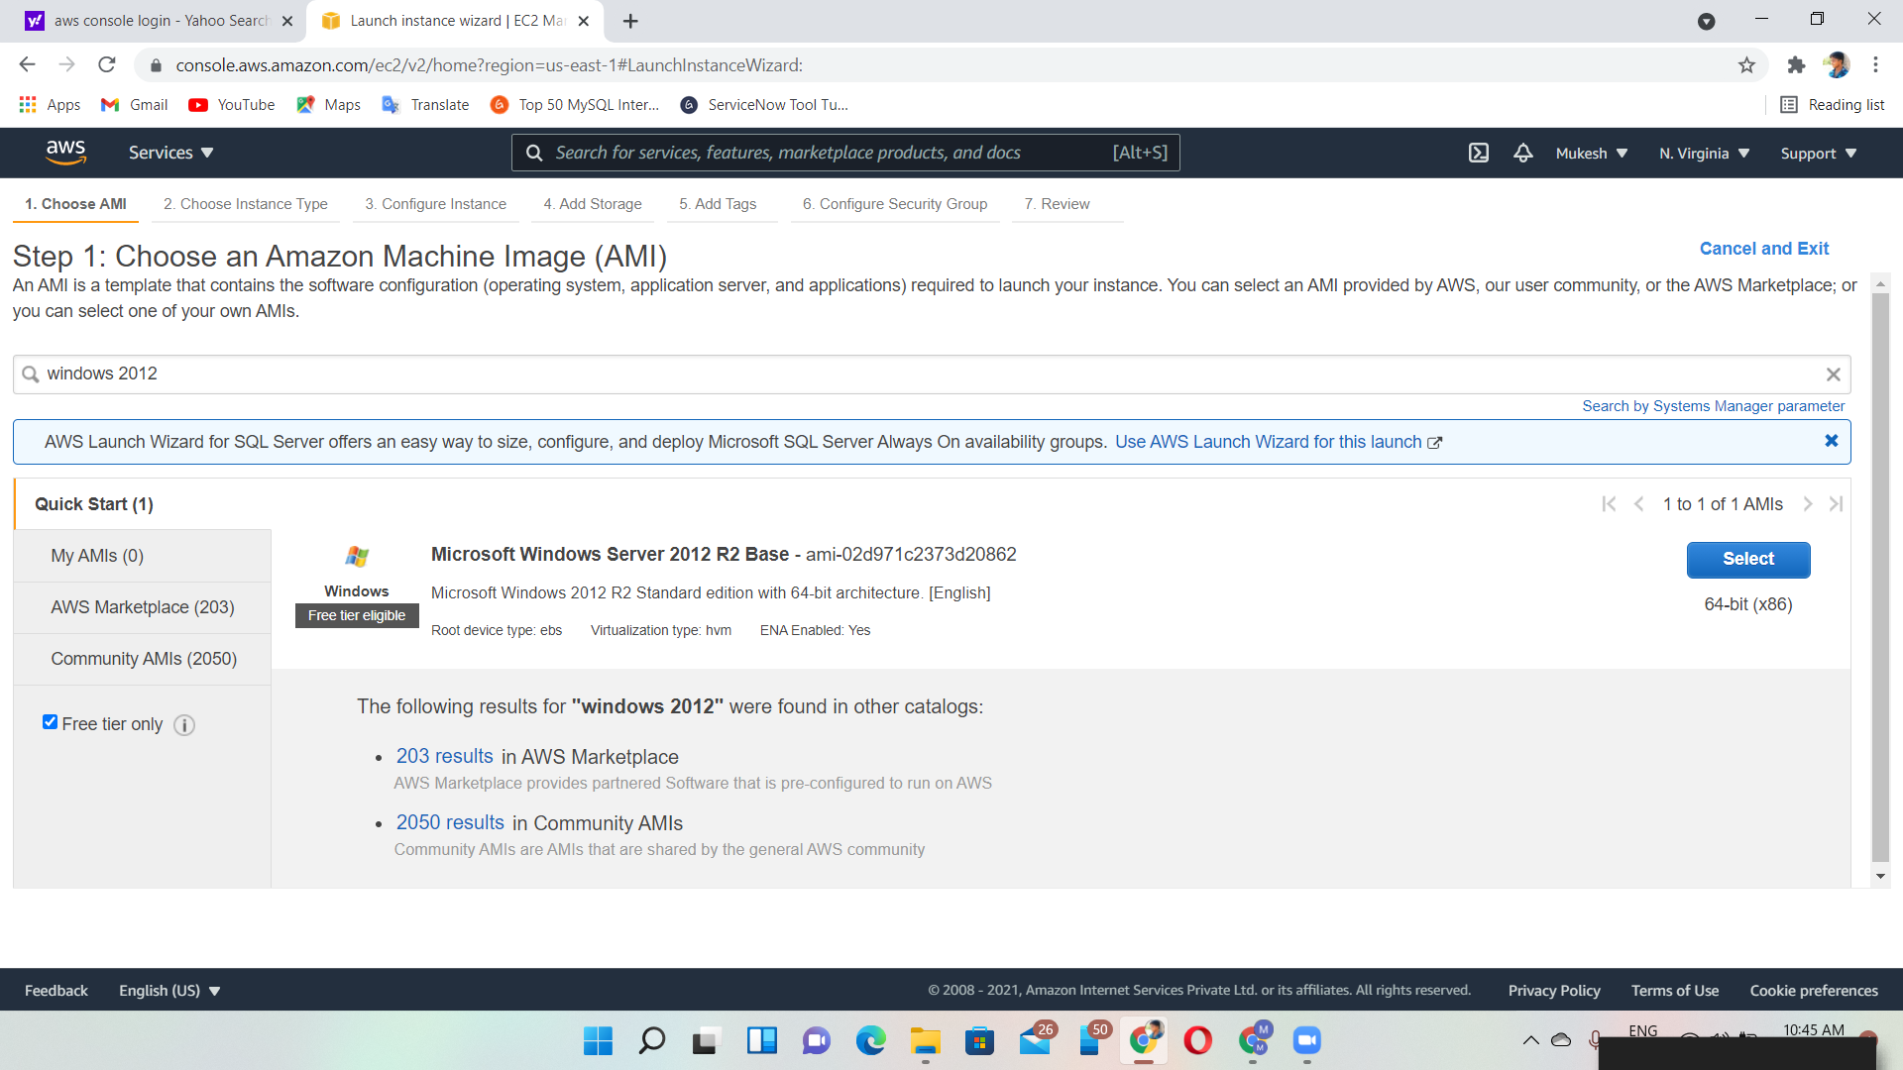
Step 1-How to choose windows image (os)

Slide 4
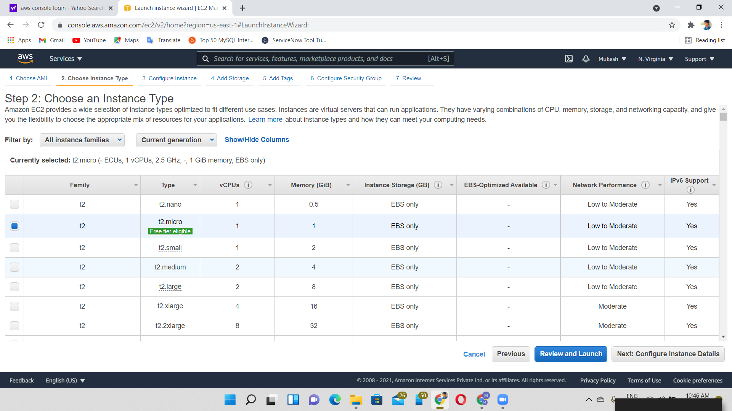
Step 2-instance types

Slide 5
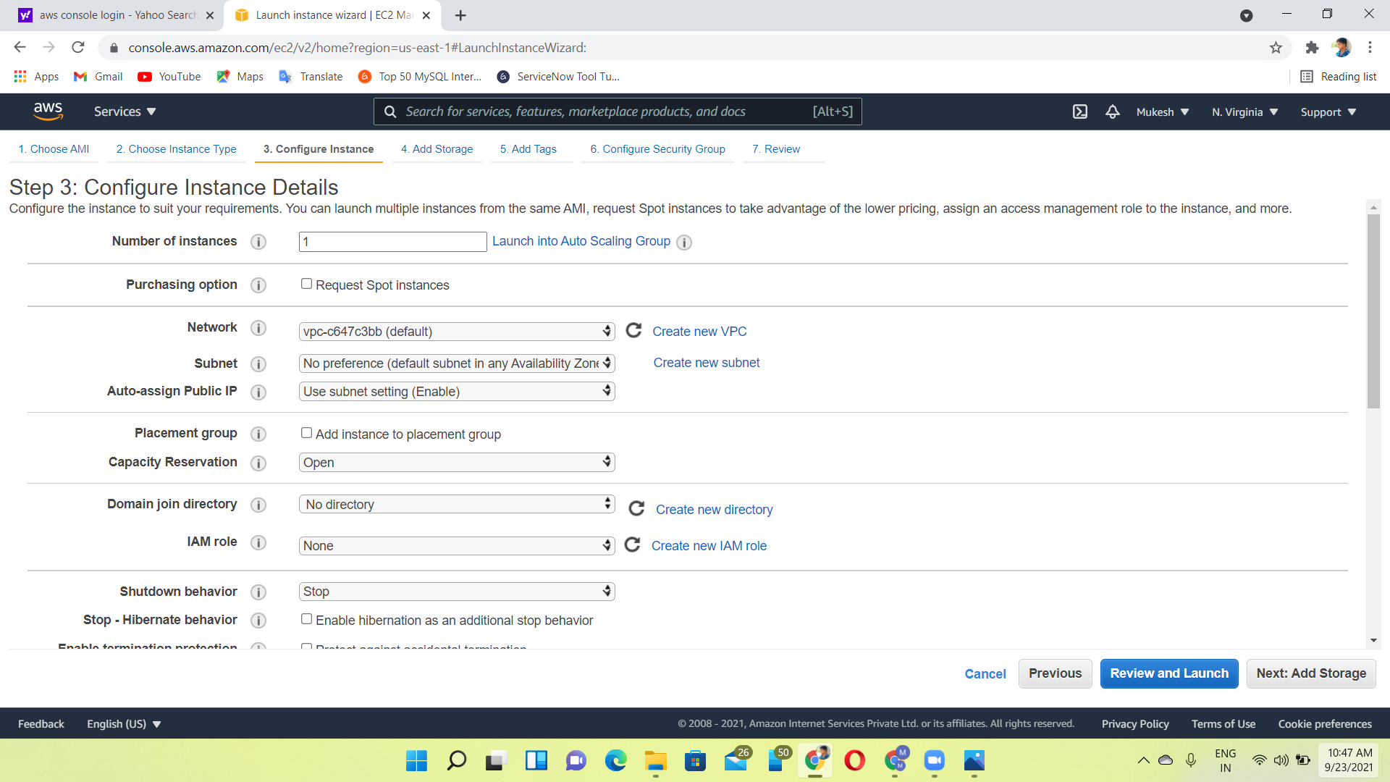
Step 3-configure instance details

Slide 6
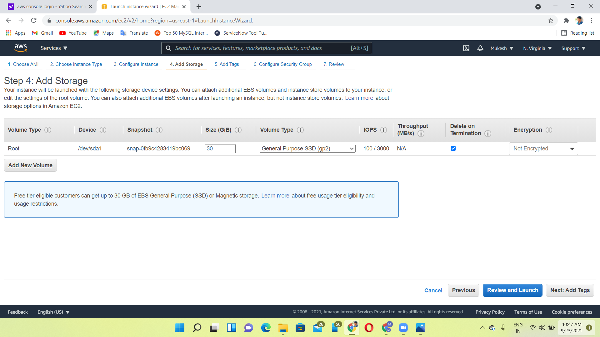
Step 4-add storage

Slide 7
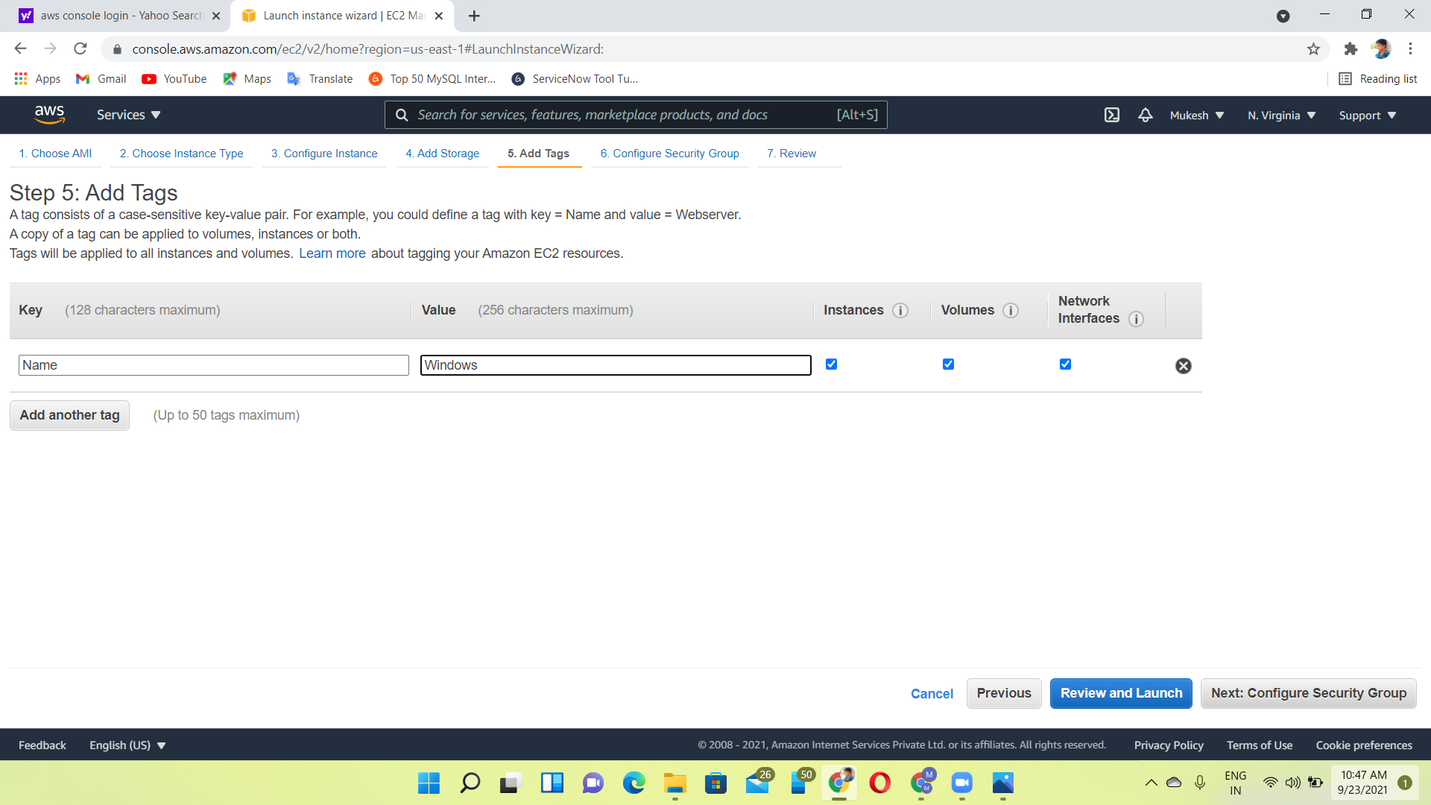
Step 5-add tags

Slide 8
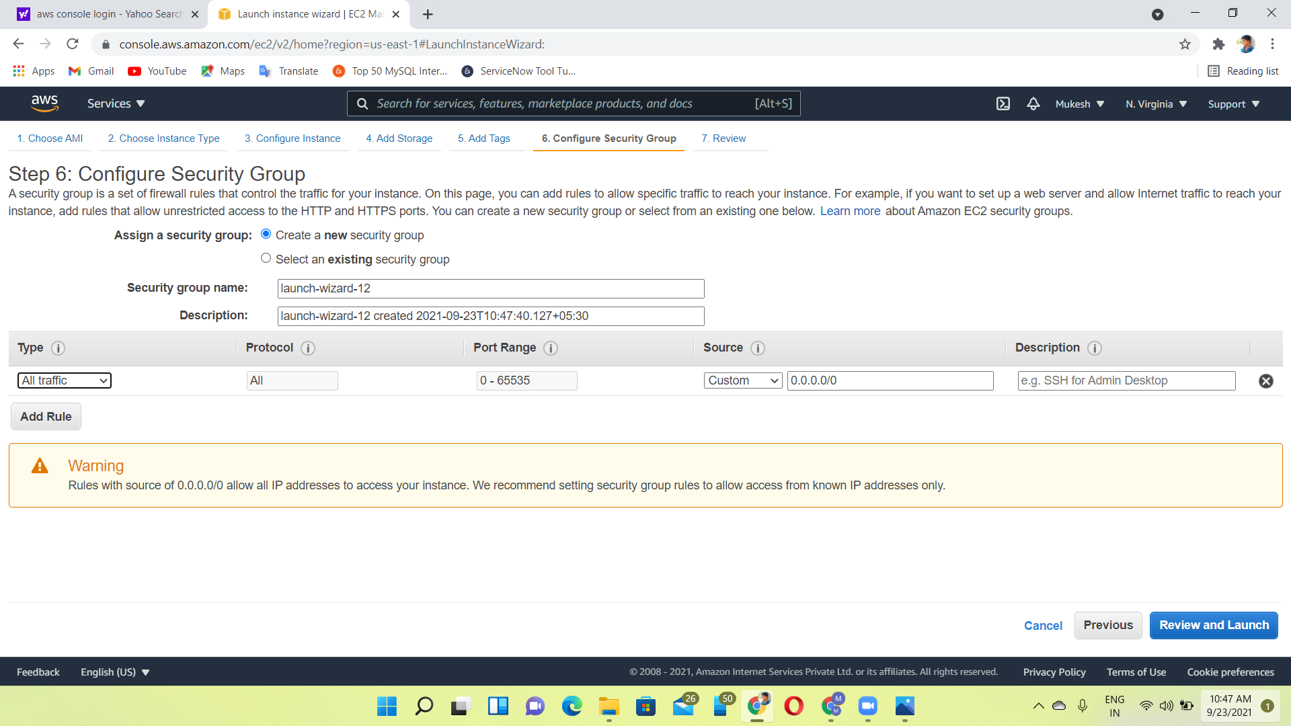
Step 6-configure security groups

Slide 9
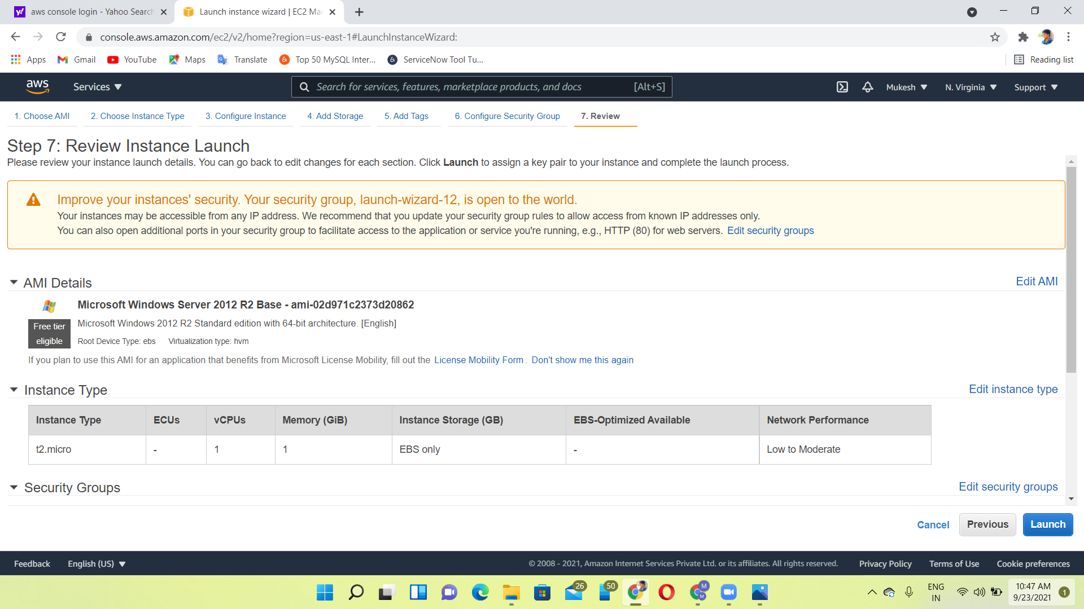
Step 7-review & launch

Slide 10
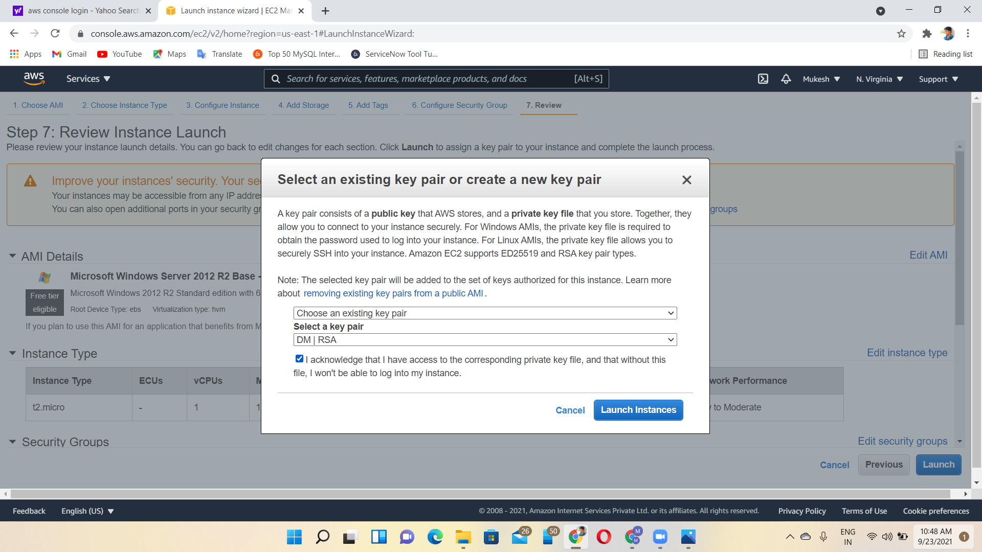
Step 8- key pair

Slide 11
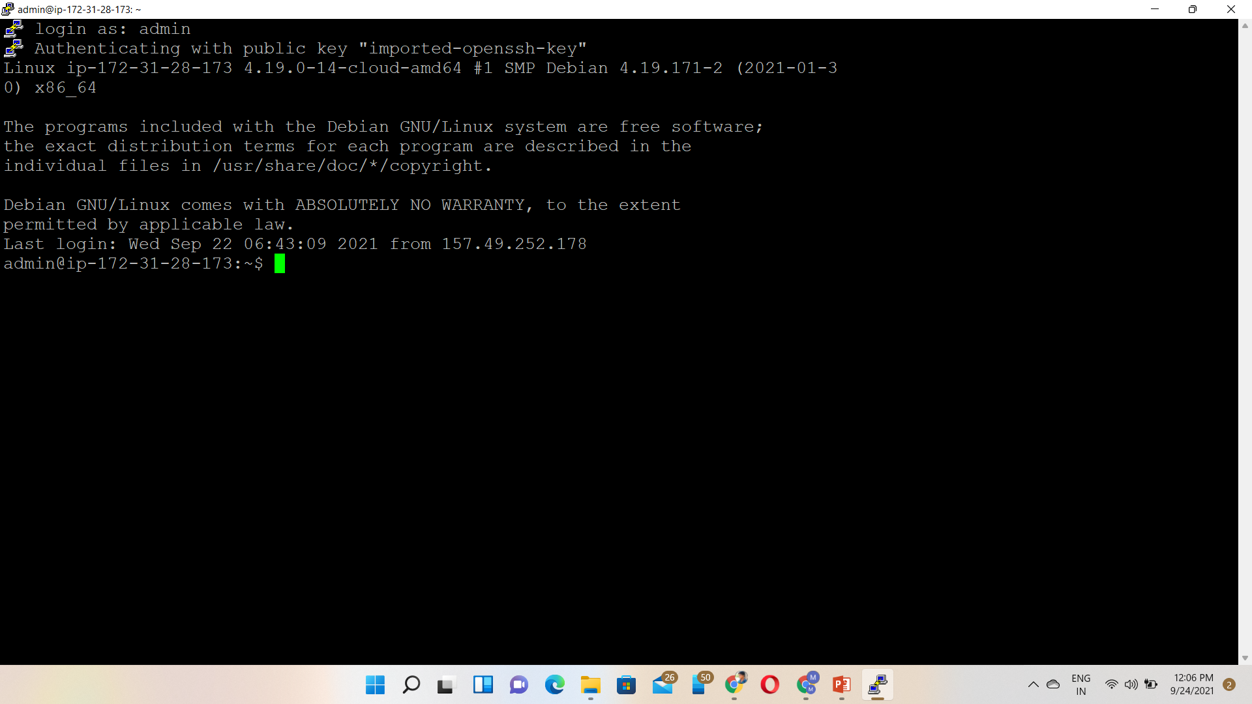
Output of linux

Slide 12
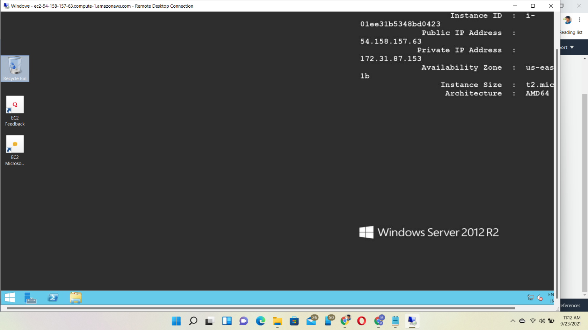
Output of windows

